Slide 1

Weekly Rhythm Presentation
Reporting Period : 12 Sept to 25 sept

Slide 2

Agenda
Incident management
Disk alert Repeated Issues
Weekly issues
Ongoing issues
Escalations (Support required) If on Emails

Slide 3
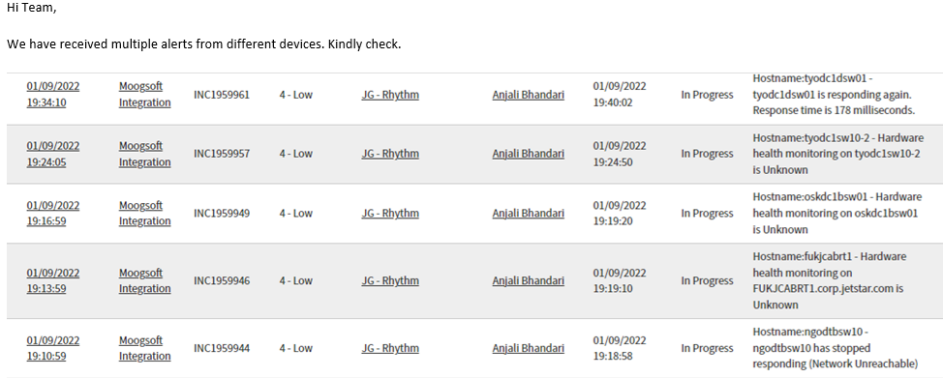
Highlights
Highlights
Total Incident Alerts for (Rhythm) = 537
We received multiple incident of different Network Device at same time.
Manual intervention required to create tickets for failed back-up jobs
Focus Areas
Frequently (once a week or within two weeks) we received multiple alerts for different network Device. And we have connected with Network team for the same.
Below are some examples:

Slide 4
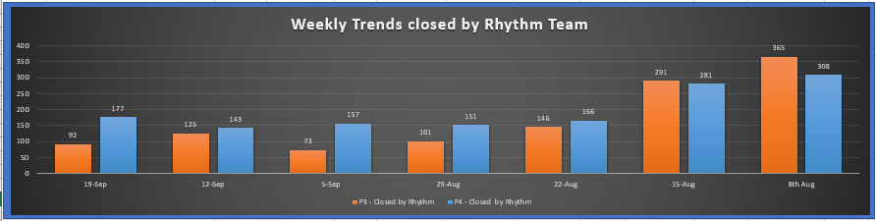
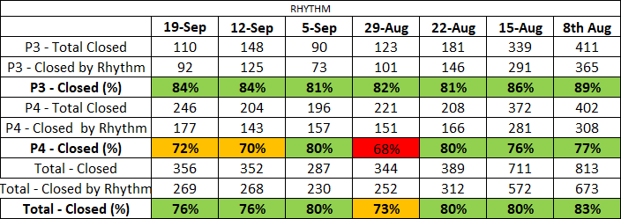
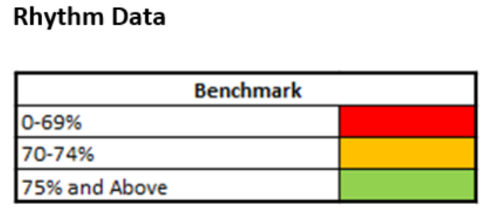
Rhythm team data : 12 Sep – 25 Sept

Slide 5
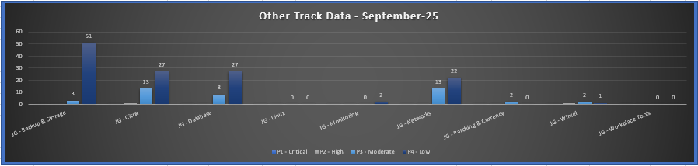
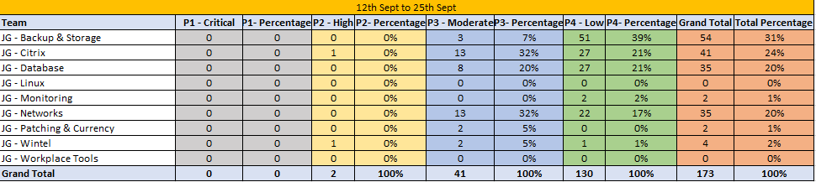
Track Team data : 12 Sep – 25 Sept

Slide 6

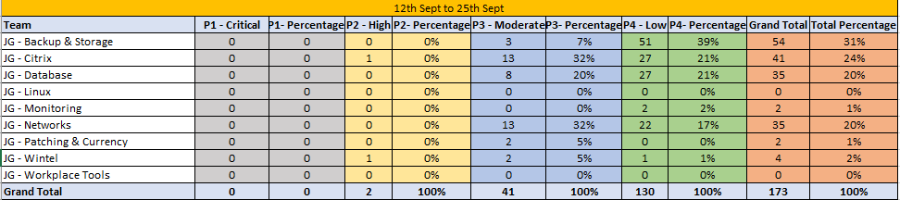
Data in Percentage Other Teams

Slide 7
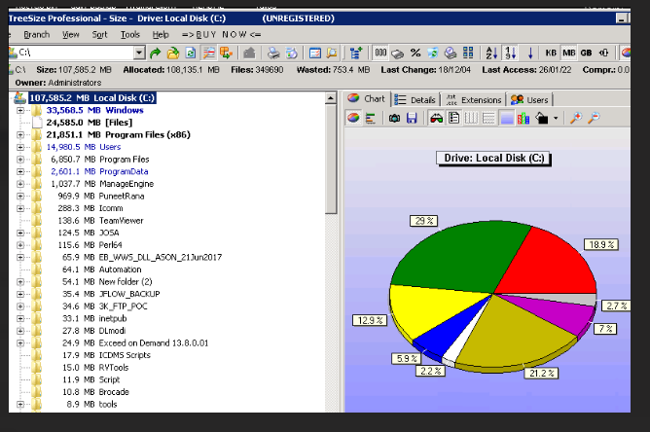
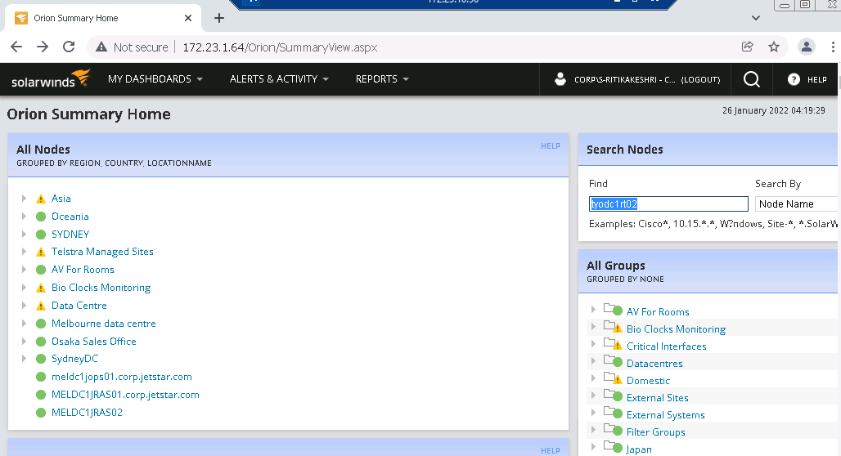
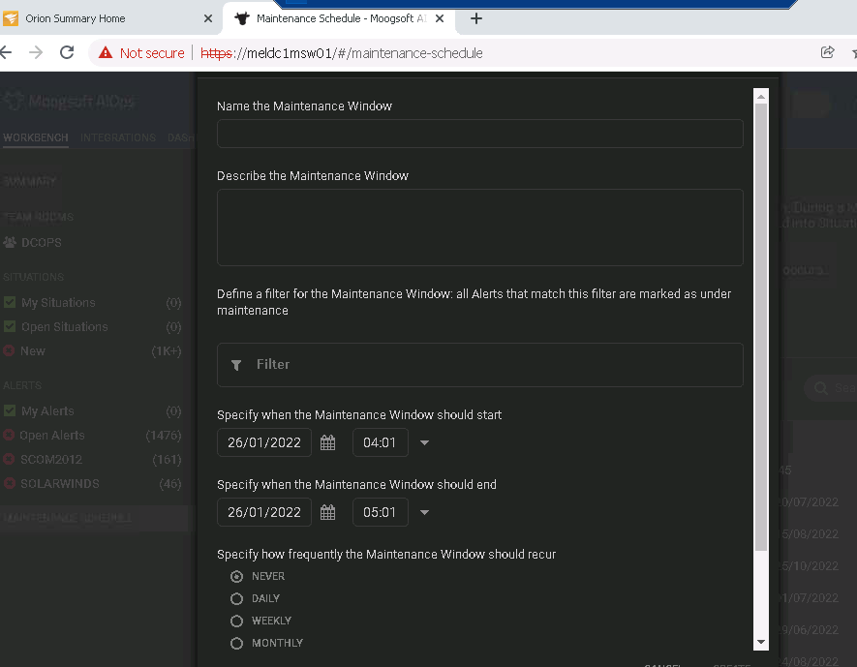
Issue Types - Examples
Disk space issues
As per the issue Rhythm team members deleted data from C: drive as they had been advised by the track teams
Incase required threshold space is not achieved than track team is notify after running the tree size report.
Solar wind
Based on reported issue Rhythm team refer to solar winds and take necessary action to resolve the issue.
Maintenance Mode
During Major activity Rhythm team receive request from different team to put the servers in MM mode.

Slide 8
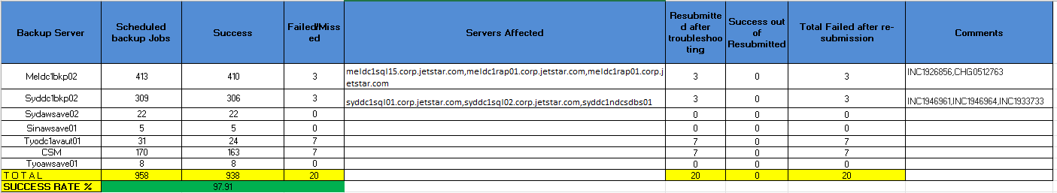
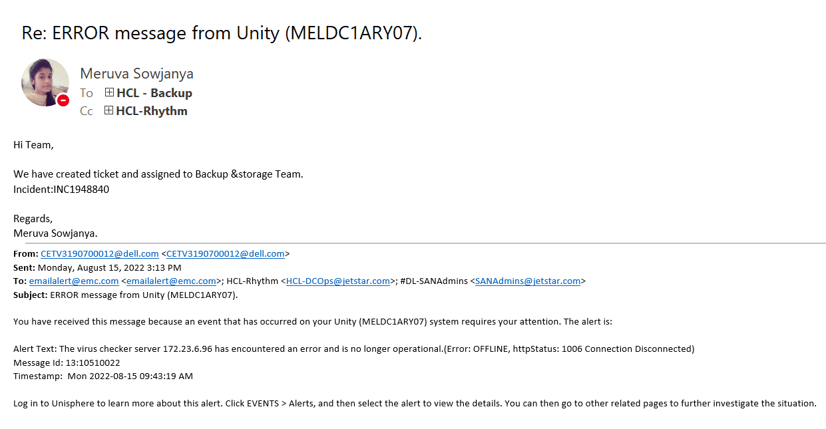
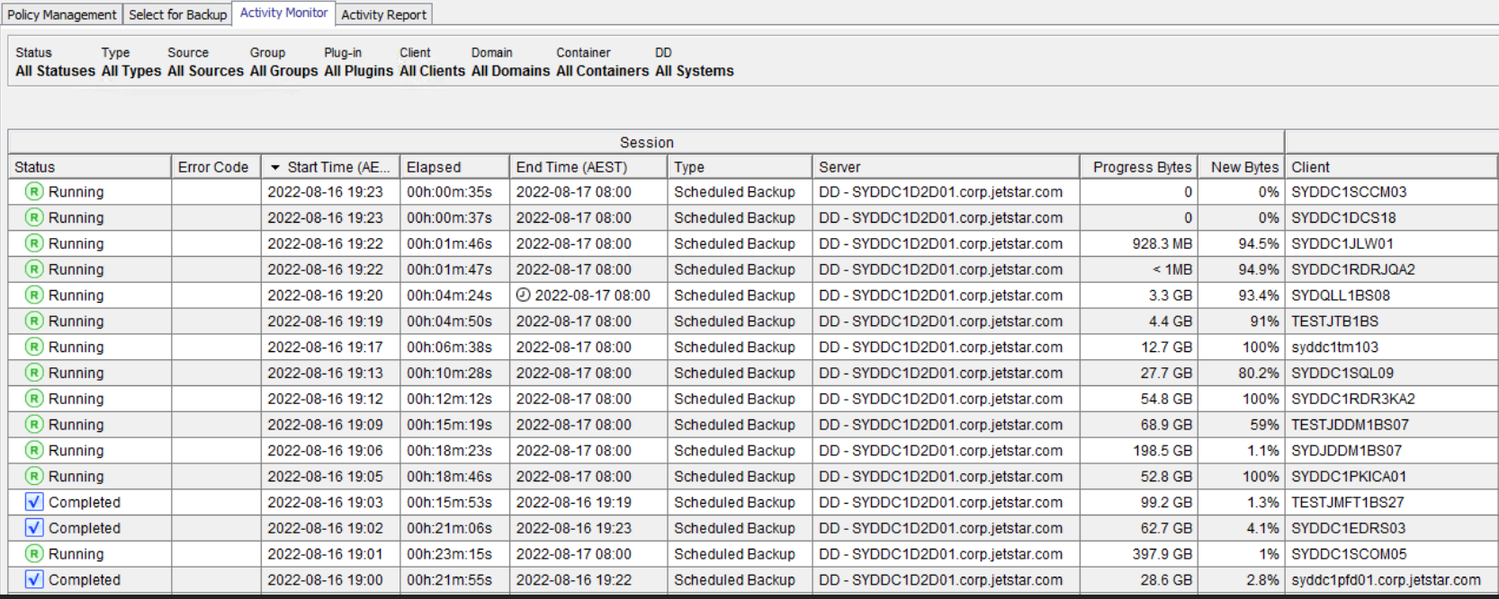
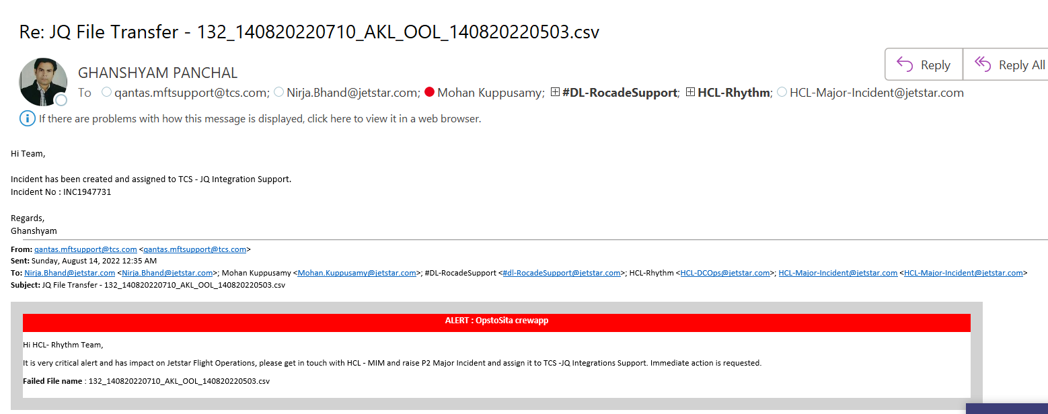
Daily Back-up Report and Alert Monitoring by Rhythm
Create Back-up report from data received daily on E-mail and also creating manual tickets for failed jobs.
Run the failed Back-up Jobs and Monitor till the time it completes.
Monitoring daily E-mails to create manual ticket if required and assigning it to different track teams.
Alert received on email to create P2 ticket and assign it to TCS -JQ Integrations Support for JQ File Transfer by E-mail.

Slide 9
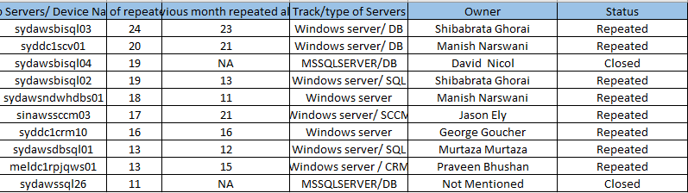
Top 10 servers
List of top servers received multiple incident for different and repeated issue

Slide 10


